Slide 1
A 0.7 V-to-1.0 V 10.1 dBm-to-13.2 dBm 60-GHz Power Amplifier Using Digitally-Assisted LDO Considering HCI Issues
Rui Wu, Yuuki Tsukui, Ryo Minami, Kenichi Okada, and Akira Matsuzawa
Tokyo Institute of Technology, Japan
Notes:
2007/10/29
0
Total 25min
20-22 minutes for talk

Slide 2
Outline
Background
– 60-GHz field is attractive
Hot-Carrier-Induced Issues
– HCI influence on circuit reliability
Variable-Supply-Voltage PA using Digitally-assisted LDO
– Circuit design & Measurement results
Conclusions
Notes:
2007/10/29
1

Slide 3

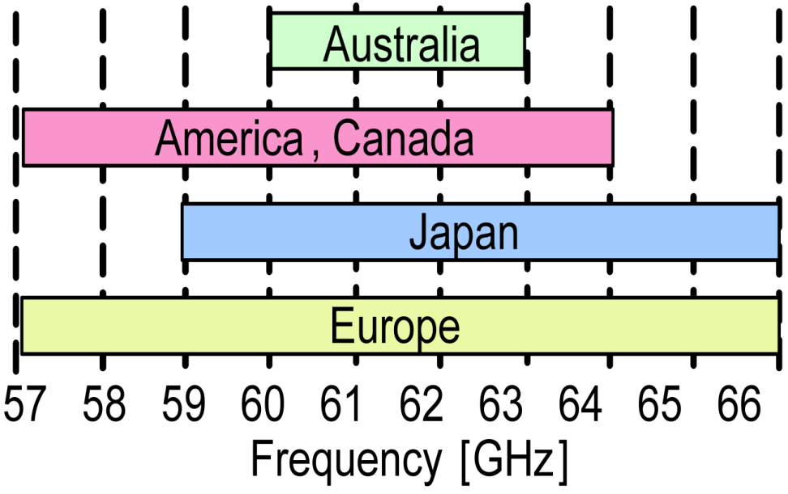

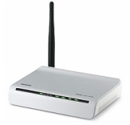


Background
9-GHz unlicensed bandwidth
Several Gbps wireless communication
e.g. IEEE 802.15.3c
QPSK→3.5 Gbps/ch
16QAM→7 Gbps/ch
[1] http://www.tele.soumu.go.jp

Slide 4
HCI Issues are Emerging at 60 GHz
60-GHz power amplifier
2.4-GHz power amplifier
Thick oxide
Standard
Standard
☺ High f_{max}, suitable for 60-GHz amplifier
☹ Bad HCI performance
☺ Good HCI performance
☹ Low f_{max}, can’t be used for 60-GHz amplifier
Notes:
Thick‐oxide transistors can be considered as devices from previous technology nodes: 0.25 and 0.18 μm. Their reliable operating voltages are 2.5 and 1.8 V, respectively
fmax related to MAG

Slide 5
Hot-Carrier-Induced (HCI) Effects
Degrade V_{th}, g_{m}, drain current, and lifetime
Notes:
Reliability issue is significant for practical 60-GHz products. HCI (hot-carrier-induced) effects are dominant for the reliability of the advanced CMOS process.
When a large voltage is applied at the drain of the MOSFET, a high lateral-electric field will exist in the channel. The carriers passing through the high field will gain considerable energy and are called as “hot” carriers. Some of these hot carriers can overcome the barrier between the Si and SiO2 and get injected into gate oxide causing various types of oxide damage. Others can create electron-hole pairs by impact ionization. These effects will degrade the drain current, threshold voltage and transconductance. Therefore reduce the lifetime of the MOSFETs

Slide 6
Tr. Lifetime Measurement Setup
• Lifetime is defined as the time when the saturation drain current (I_{DSat}) decreases by 10% from its unstressed value
Notes:
The lifetime is defined as the time when the drain current
of the transistor (IDS) decreases by 10% from the unstressed
value.

Slide 7
Tr. Lifetime Measurement Procedure

Slide 8
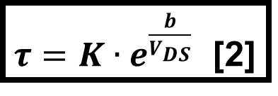
65 nm NMOSFET DC Stress Lifetime
10¹⁰
Stress condition
V_{DS}
10⁸
10⁶
V_{GS}
Lifetime τ (s)
10⁴
V
V_{DS}
10²
$τ=K∙e^{\frac{b}{V_{DS}}}$ [2]
V_{GS} = 0.8 V
10⁰
t
1/V_{DS} (1/V)
[2] E. Takeda et al., IEDL 1983
Notes:
Tr. W 2x10; K=1.5e-7;b=44.6;
Stress Vds=2 V LT=700 s=12 mins, Vds=1.2 V LT=2e09 (2 billion)=63 years;
Stress Vgs=0.8 V;
Sample Vds=1.2 V Vgs=0.8 V
The lifetime is defined as the time when the drain current
of the transistor (IDS) decreases by 10% from the unstressed
value.

Slide 9
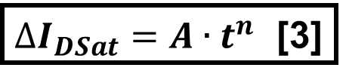
65 nm NMOSFET RF Stress Lifetime
Stress condition
Freq.=100 MHz,
P_{o}=11 dBm
V_{ds}
V_{gs}
∆I_{DSat} (%)
V_{ds}
V_{gs}
1.2 V
0.8 V
10²
10³
10⁴
10⁵
t
Time (s)
[3] L. Negre et al., JSSC 2012
Notes:
Tr. W=2x40 um; A=0.5053; n=0.333; Lifetime=8000s=2 hours;
Bias Vds=1.2 V Vgs=0.8 V
Freq. =100MHz
Stress Pin=-1.26 dBm Pout=11 dBm; Vswing about 2.2 V
Sim. Vg_pp=1.1 V; Vd_pp=1.9 V

Slide 10
Conventional Solutions
Cascode [4]
Power combining [6]
Low V_{dd} [5]
☺ Better lifetime
☹ Degraded output power, efficiency, and linearity
☺ Better lifetime, output power, and linearity
☹ Sensitive to process variations
[4] A. Siligaris et al., JSSC 2010
[5] M. Tanomura et al., ISSCC 2008
[6] J. Chen et al., ISSCC 2011
Notes:
[2]MINATEC, France [3] NEC [4] UCB, Niknejad
Different phase delay for different paths

Slide 11
Time-Division Duplex (TDD) Operation
• TDD operation can eliminate the stringent requirement of filtering and extend the available bandwidth for transceivers.
In IEEE 802.11ad, short inter-frame space (SIFS) is indicated to be 3μs
Notes:
SIFS determine the time requirement of on/off switching.
Fast awaking is required

Slide 12
The Proposed Power Amplifier
Notes:
Coarse Tr. 4x255=1020 um , Fine Tr. 4x48=192 um
On-chip decoupling cap.=86 pF
R1=R2=50 kohm ,C1=2 pF;
Rfb=5 kohm, Cfb=1 pF;

Slide 13

Transient Operation of the LDO(1/3)
Notes:
Wakeup time is less than 0.1us

Slide 14
Transient Operation of the LDO(1/3)
Notes:
Coarse Tr. 4x255=1020 um , Fine Tr. 4x48=192 um
On-chip decoupling cap.=86 pF
R1=R2=50 kohm ,C1=2 pF;
Rfb=5 kohm, Cfb=1 pF;

Slide 15
Transient Operation of the LDO(2/3)
Notes:
Wakeup time is less than 0.1us

Slide 16
Transient Operation of the LDO(2/3)
Notes:
Coarse Tr. 4x255=1020 um , Fine Tr. 4x48=192 um
On-chip decoupling cap.=86 pF
R1=R2=50 kohm ,C1=2 pF;
Rfb=5 kohm, Cfb=1 pF;

Slide 17
Transient Operation of the LDO(3/3)
Notes:
Wakeup time is less than 0.1us

Slide 18
Transient Operation of the LDO(3/3)
Notes:
Coarse Tr. 4x255=1020 um , Fine Tr. 4x48=192 um
On-chip decoupling cap.=86 pF
R1=R2=50 kohm ,C1=2 pF;
Rfb=5 kohm, Cfb=1 pF;

Slide 19
Differential PA Topology
The cross-coupling capacitor technique is adopted to improve the stability and power gain
Notes:
2x20 um/0.06 um; 2x30 um/0.06 um; 2x40 um/0.06 um;
Power requirement for each transistor is relieved
The HCI effects on the PA are further alleviated owing to the adoption of the differential topology

Slide 20
Die Micro-photograph
700 μm
800 μm
Notes:
PA core 0.132mm²; LDO 0.025mm²; C_{L} 86 pF, 0.051mm²

Slide 21
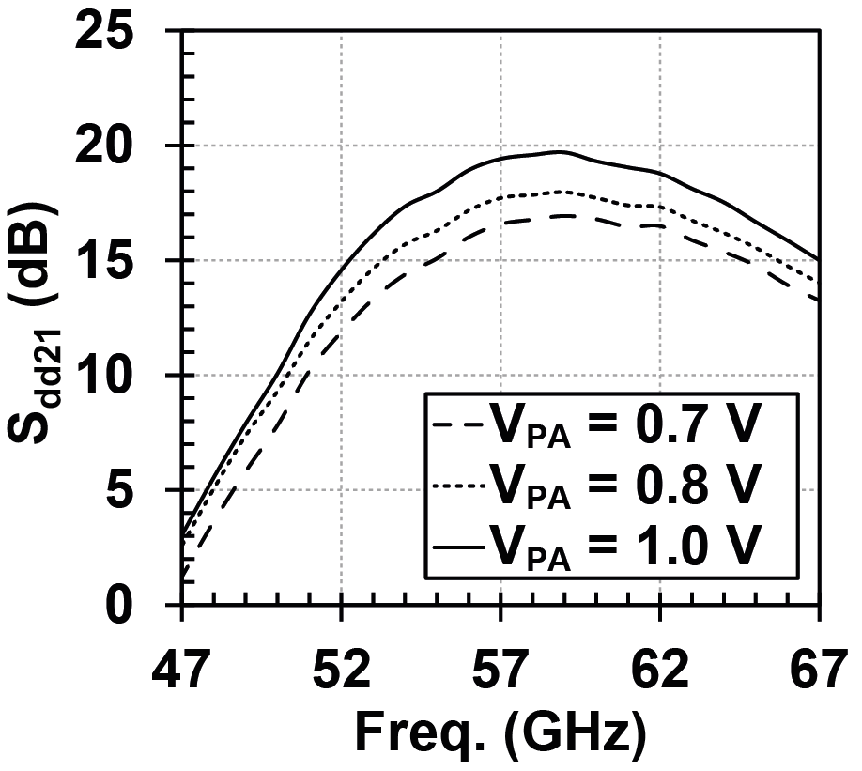
Measured Small-Signal S-parameter
Notes:
3-dB bandwidth is about 13 GHz (from 53 GHz to 66 GHz);
Peak gain =19.7 dB@59 GHz, V_{PA}=1.0 V;
Peak gain =17.0 dB@59 GHz, V_{PA}=0.7 V;

Slide 22
PA Performance vs V_{PA} @60 GHz
P_{sat}
P_{1dB}
P_{sat} and P_{1dB} (dBm)
PAE_{max} (%)
PAE_{max}
V_{PA} (V)

Slide 23
Measured Lifetime of the PA
V_{PA}=1.00 V, P_{out}=10 dBm
V_{PA}=1.00 V, P_{out}=5 dBm
V_{PA}=0.75 V, P_{out}=5 dBm
∆I_{DSat} (%)
1
10²
10⁴
10⁶
10⁸
10¹⁰
Time (s)
Notes:
V_{PA}=1.00 V, P_{out}=10 dBm, lifetime=0.2 year;A1=0.1512,N1=0.2674
V_{PA}=1.00 V, P_{out}=5 dBm, lifetime=1.8 year;A2=0.0532,N2=0.2936
V_{PA}=0.75 V, P_{out}=5 dBm, lifetime>30 year;A3=0.003,N3=0.294
Freq. = 60 GHz

Slide 24
Measured Output Spectrum
IEEE 802.15.3c Spectrum mask
Magnitude (dB)
Magnitude (dB)
Centered Freq. (GHz)
Centered Freq. (GHz)
(a)
(b)
Spectrum centered at 62.64 GHz for QPSK modulation
(a) V_{PA}=1.0 V, P_{out}=4 dBm; (b) V_{PA}=0.7 V, P_{out}=3 dBm
Notes:
channel 3 (61.56 GHz to 63.72 GHz ); symbol rate 1.76 Gs/s

Slide 25
Measured EVM for QPSK Modualtion
EVM (dB)
V_{PA} (V)
Notes:
channel 3 (61.56 GHz to 63.72 GHz ); symbol rate 1.76 Gs/s

Slide 26
60 GHz CMOS PA Performance Comparison
Ref. | Process | Vdd (V) | P_{1dB} (dBm) | P_{sat} (dBm) | PAE_{max} (%) | Lifetime (year)
[4] | 65 nm SOI | 1.2 | 7.1 | 10.5 | 22.3 | N/A
 |  | 1.8 | 12.7 | 14.5 | 25.7
 |  | 2.6 | 15.2 | 16.5 | 18.2
[5] | 90 nm | 0.7 | 5.2 | 8.5 | 7.0 | > 10⁵*
 |  | 1.0 | 10.5 | 11.5 | 8.5 | > 10*
[6] | 65 nm | 1.0 | 15.0 | 18.6 | 15.1 | N/A
[7] | 65 nm | 1.0 | 8.0 | 11.5 | 15.2 | > 10*
This work | 65 nm | 0.7† | 5.8 | 10.1 | 8.1 | > 10²
 |  | 1.0† | 10.2 | 13.2 | 15.0 | > 0.2
† Only for the last stage V_{PA}
* Non-measured results
[4] A. Siligaris et. al, JSSC 2010
[5] M. Tanomura et. al, ISSCC 2008
[6] J. Chen et. al, ISSCC 2011
[7] W. L. Chan et. al, JSSC 2010

Slide 27
Conclusions
– The lifetime of the proposed PA can be improved dramatically by dynamic operation.
– The tunable supply offers a possibility to meet different linearity, efficiency, output power and lifetime requirements in actual applications.
– The PA is insensitive to the process variations thanks to the tunable supply voltage.
Notes:
fabricated in a standard 65-nm CMOS process

Slide 28
Thank you for your attention!

